Slide 1
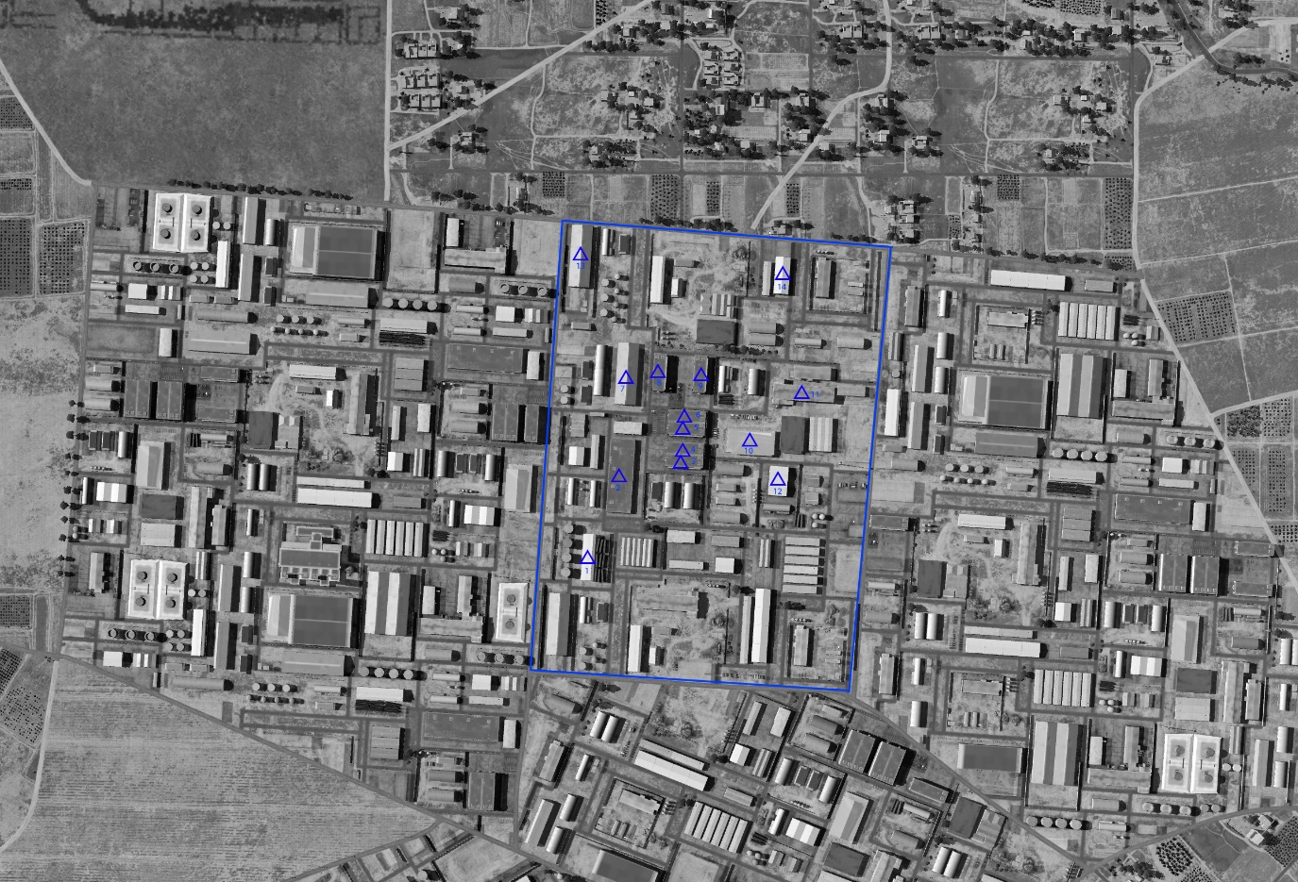

SYTGT016 HOMS AMMUNITION FACTORY
N
16
DESIRED POINT of IMPACT:
DPI 14 - N34 45.738 E 36 40.957 / 1583ft / 2000lb PGM
DPI 13 - N34 45.738 E 36 40.736 / 1578ft / 2000lb PGM
DPI 12 - N34 45.289 E 36 40.954 / 1596ft / 2000lb PGM
DPI 11 - N34 45.366 E 36 40.984 / 1596ft / 2000lb PGM
DPI 10 - N34 45.322 E 36 40.925 / 1596ft / 2000lb PGM
DPI 9 - N34 45.380 E 36 40.869 / 1595ft / 2000lb PGM
DPI 8 - N34 45.380 E 36 40.825 / 1595ft / 2000lb PGM
DPI 7 - N34 45.380 E 36 40.790 / 1600ft / 2000lb PGM
DPI 6 - N34 45.345 E 36 40.855 / 1598ft / 2000lb PGM
DPI 5 - N34 45.332 E 36 40.855 / 1597ft / 2000lb PGM
DPI 4 - N34 45.316 E 36 40.855 / 1594ft / 2000lb PGM
DPI 3 - N34 45.303 E 36 40.854 / 1594ft / 2000lb PGM
DPI 2 - N34 45.292 E 36 40.787 / 1592ft / 2000lb PGM
DPI 1 - N34 45.215 E 36 40.756 / 1593ft / 2000lb PGM
CDC - High density civilian housing 350m South of facility.

Slide 2
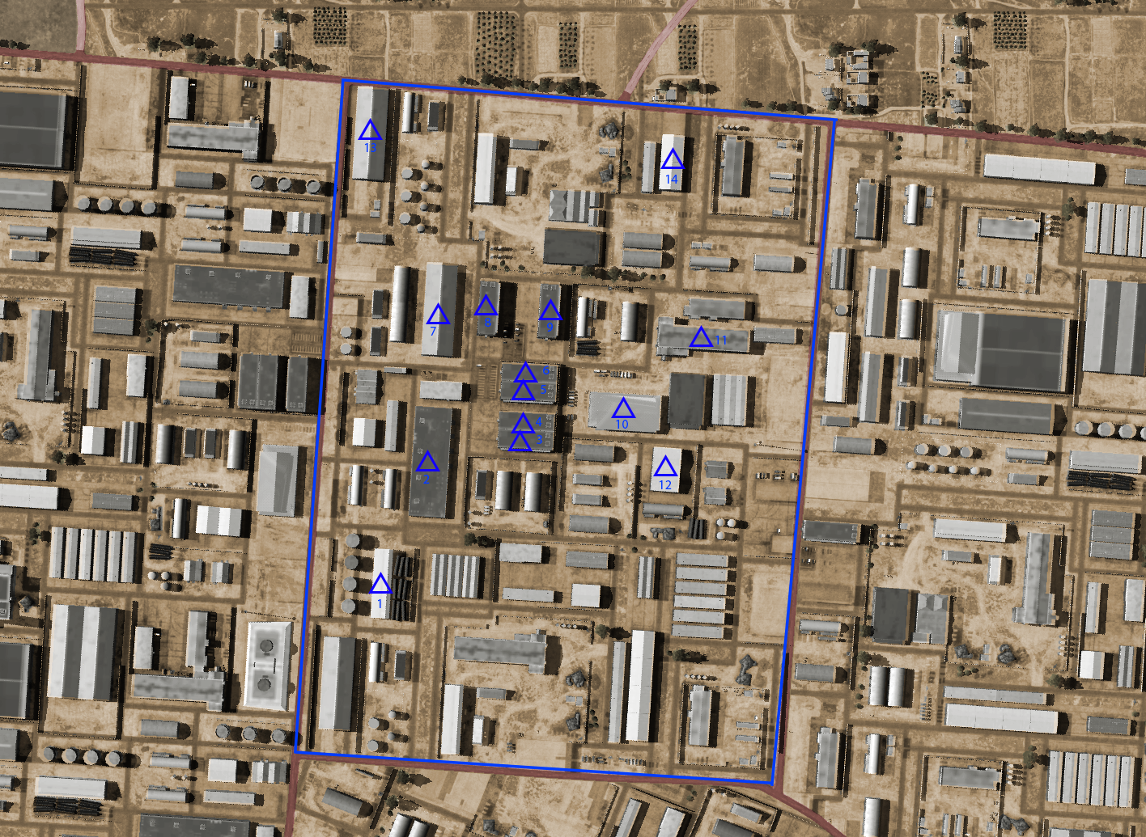
OPARTGT016 HOMS AMMUNITION FACTORY
N
16
DESIRED POINT of IMPACT:
DPI 14 - N34 45.738 E 36 40.957 / 1583ft / 2000lb PGM
DPI 13 - N34 45.738 E 36 40.736 / 1578ft / 2000lb PGM
DPI 12 - N34 45.289 E 36 40.954 / 1596ft / 2000lb PGM
DPI 11 - N34 45.366 E 36 40.984 / 1596ft / 2000lb PGM
DPI 10 - N34 45.322 E 36 40.925 / 1596ft / 2000lb PGM
DPI 9 - N34 45.380 E 36 40.869 / 1595ft / 2000lb PGM
DPI 8 - N34 45.380 E 36 40.825 / 1595ft / 2000lb PGM
DPI 7 - N34 45.380 E 36 40.790 / 1600ft / 2000lb PGM
DPI 6 - N34 45.345 E 36 40.855 / 1598ft / 2000lb PGM
DPI 5 - N34 45.332 E 36 40.855 / 1597ft / 2000lb PGM
DPI 4 - N34 45.316 E 36 40.855 / 1594ft / 2000lb PGM
DPI 3 - N34 45.303 E 36 40.854 / 1594ft / 2000lb PGM
DPI 2 - N34 45.292 E 36 40.787 / 1592ft / 2000lb PGM
DPI 1 - N34 45.215 E 36 40.756 / 1593ft / 2000lb PGM
CDC - High density civilian housing 350m South of facility.

